Slide 1
Digital Control Systems
Chapter 7

Slide 2
Review
Basics about discrete-data control systems (digital control systems)
Interfaces between continuous and discrete-data systems ----- the Sample-and-hold device
Tools for analyzing and synthesizing discrete-data systems ----- the z-transform and inverse z-transform
Discrete-data models of control systems
Pulse-transfer functions
Discrete state equation
Discretization of continuous system
  from transfer function to z-transfer function
  from state equation to discrete state equation

Slide 3
Outlines
Stability assessment of discrete-data systems
Steady-state error of discrete-data systems
Transient response of a discrete-data system
Mapping between s-plane and z-plane trajectory
Design a discrete-data controller through discretizing a continuous-data controller
Design a discrete-data controller in the z-plane

Slide 4
How to assess the stability of a digital system
For a continuous system, we can use Routh-Hurwitz criterion to assess the stability of the system.
Can we use Routh-Hurwitz criterion to assess the stability of a digital system?

Slide 5



投票
最多可选1项
Is there any difference between the following two characteristic equations?
Continuous system
Digital system
A
Yes
B
No
提交

Slide 6
投票
最多可选1项
Can we use Routh-Hurwitz criterion to evaluate the stability of a discrete-data system?
A
Yes, we can!
B
No, we can not
提交

Slide 7
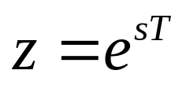
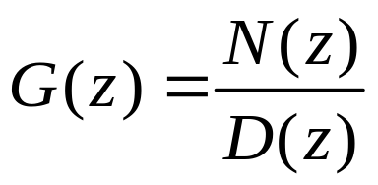

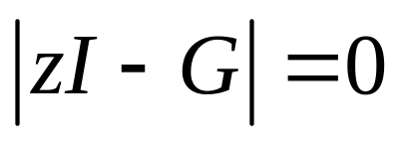

Analysis of Discrete-Date Control Systems
Stability of discrete-data control systems
j
ω
Im
z
Z-plane
S-plane
0
σ
0
1
Re
z
For a discrete-data control system to be stable, it is sufficient and necessary
that all the characteristic roots of the system are located inside unit-circle on
the z-plane

Slide 8
Analysis of Discrete-Date Control Systems
Stability of discrete-data control systems
j
ω
Im
z
Z-plane
S-plane
0
σ
0
1
Re
z
If we apply Routh-Hurwitz criterion to a z-transfer function, what do we get?

Slide 9
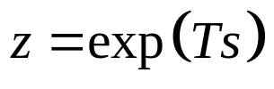

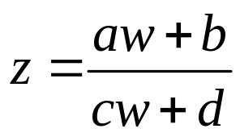
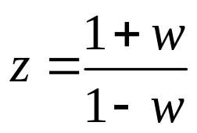
Stability Tests of Discrete-Date Systems
We can still apply the Routh-Hurwitz criterion to discrete-data systems if we
could find a transformation that transforms the unit circle in the z-plane onto
the imaginary axis of another complex plane. We cannot use z - transform
relation or , since it would transform an algebraic
equation in z into a nonalgebraic equation in s, and the Routh test still cannot
be applied. However, there are many bilinear transformations of the form
where a, b, c, d are real constants, and w is a complex variable, that will transform
circles in the z-plane onto straight lines in the w-plane. One such transformation
that transforms the interior of the unit circle of the z-plane onto the left half of the
w-plane

Slide 10
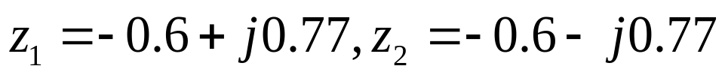


Stability Tests of Discrete-Date Systems
Once the characteristic equation in z domain is transformed into the w domain, the
Routh-Hurwitz criterion can again be applied to the equation in w.
Example – 7.17 Evaluate the stability of the following discrete-data systems.
(1)
A: calculate the characteristic roots directly
they lie inside the unit circle, so the system is stable.
(2)
A: use Routh criterion. Do the w-transformation first

Slide 11
Create the Routh table:
w³
2.5
-0.1
w²
-10.3
15.9
w¹
-3.76
0
w⁰
15.9
0
The sign of the first column changes twice, there are two characteristic
roots lie in the right half of the w-plane, so the system is unstable.

Slide 12
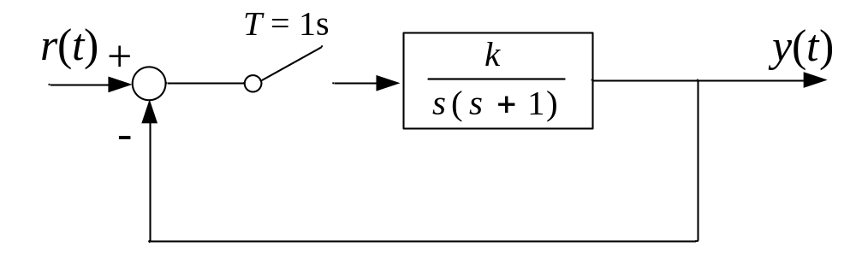
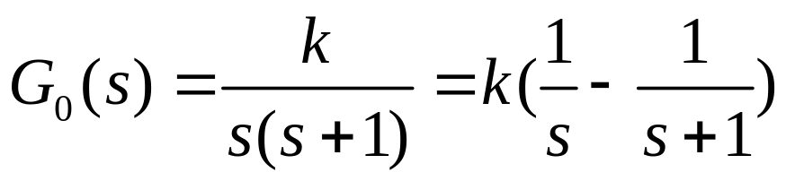
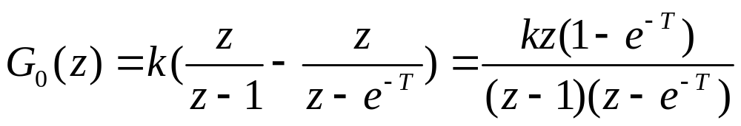
Example - 7.18
Q: please find the feasible range of k to make the following system stable.
A:
for continuous system
for discrete-data system
The characteristic equation of the closed-loop system

Slide 13




Considering T=1s,
Apply w-transformation
yields:
stability condition:
when T=0.1s, the stability region of k is
Conclusion: the smaller the sampling period is, the larger the stability region is.

Slide 14
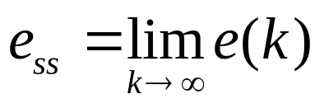
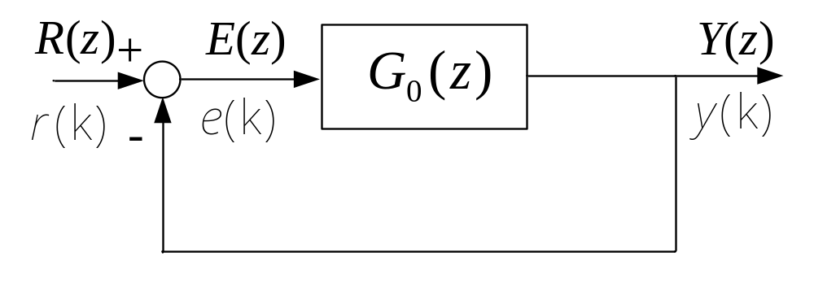
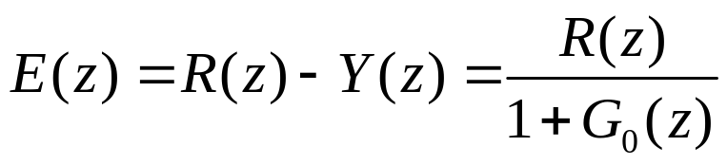
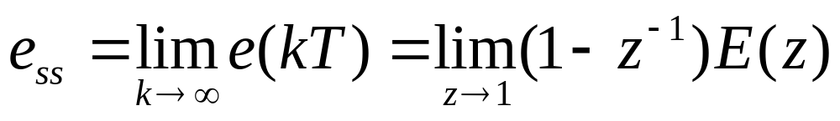
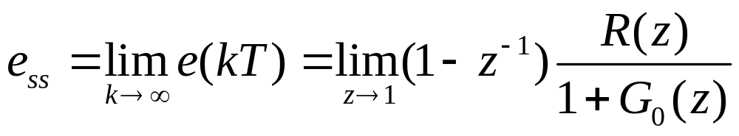
Steady-State Error of Discrete-Date Systems
Definition of the steady-state error:
The final-value theorem of z-transform is applied here to calculate the steady-
state error of a discrete-data system. When the discrete data system is stable
The number of the z=1 poles of the open-loop z-transfer function determines
the type of the system.

Slide 15
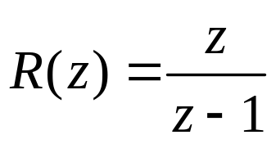

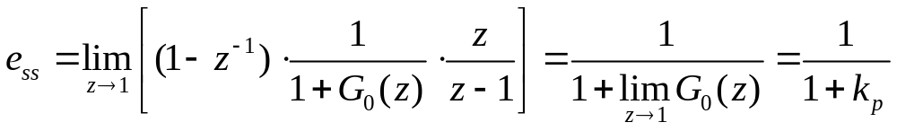

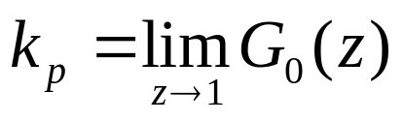
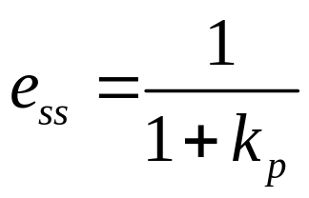
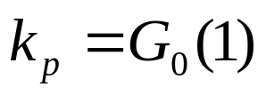
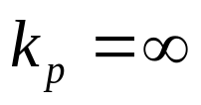
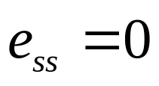
Steady-State Error of Discrete-Date Systems
The steady-state error to a unit-step input:
is named as step-error constant.
Type 0 system:
TypeⅠ and Ⅱ system

Slide 16
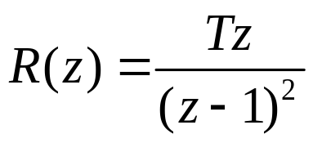

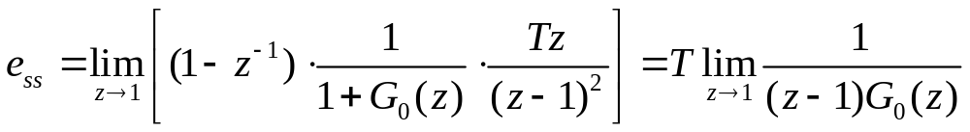
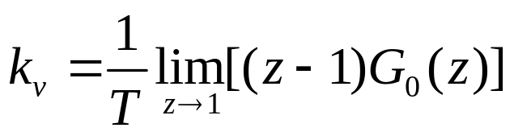

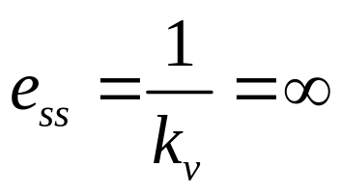
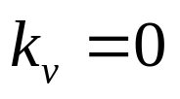
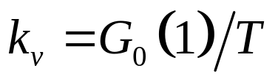
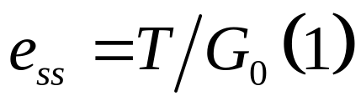
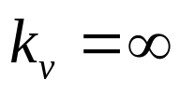
Steady-State Error of Discrete-Date Systems
The steady-state error to a unit-ramp input:
is named as ramp-error constant.
Type 0 system:
TypeⅠ system:
Type Ⅱ system:

Slide 17
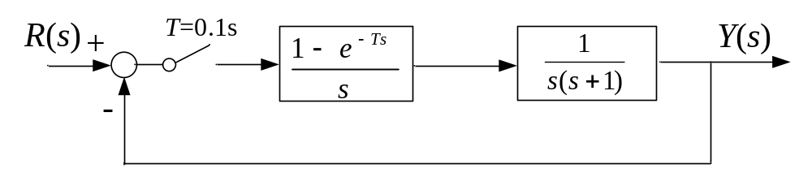
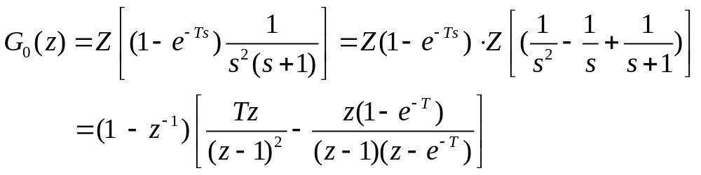
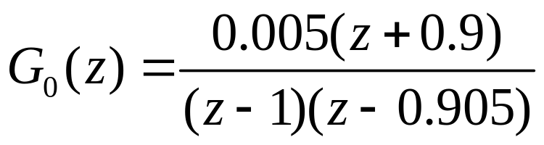
Example - 7.19
Q: please find the steady-state error of the following system to a unit-step input.
A:
Substitute T=0.1 into the above equation:

Slide 18
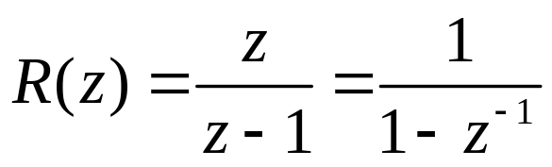
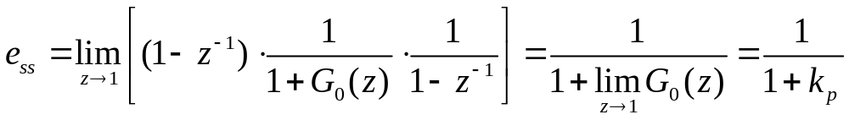
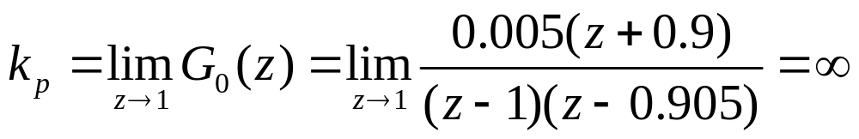
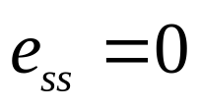
z-transform of the unit-step function:

Slide 19
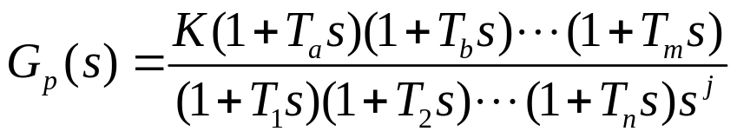
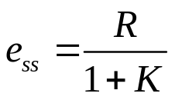

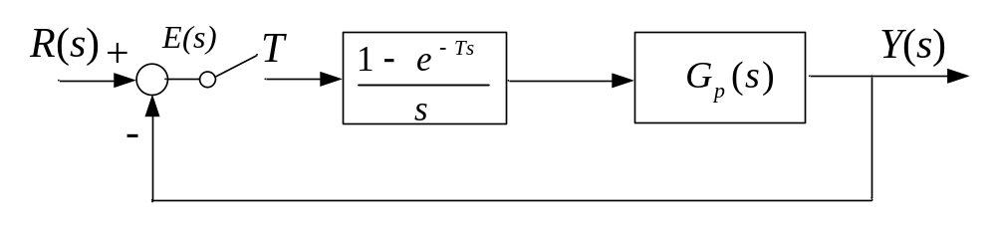
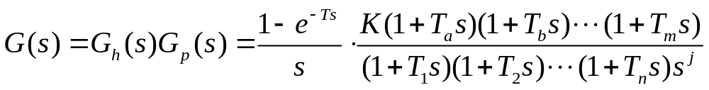
Example
Q: A discrete data system is shown as follows. Given the transfer function
Prove the type 0 system has steady-state error when the input is a step function
Prove:
The open loop transfer function of the above system is:

Slide 20
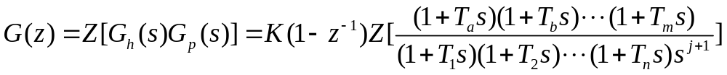
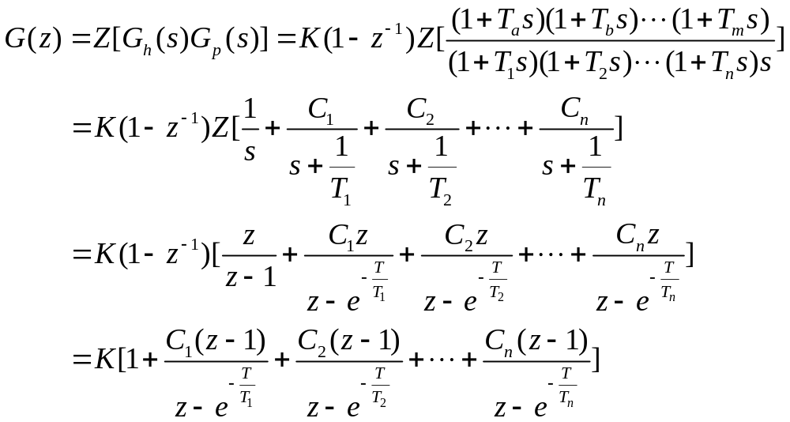
Discretize the above transfer function:
For type 0 system, we have:

Slide 21
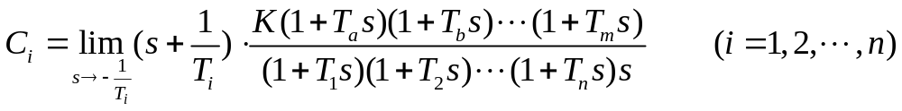
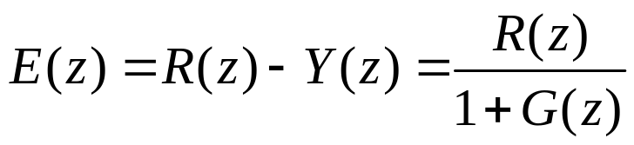
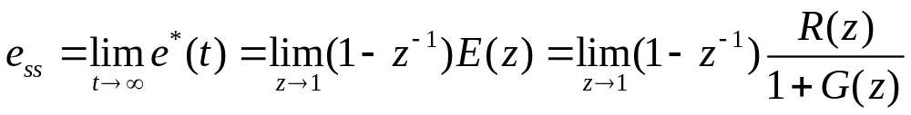
In above equation:
From the picture:
Suppose the system is stable:

Slide 22
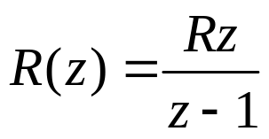

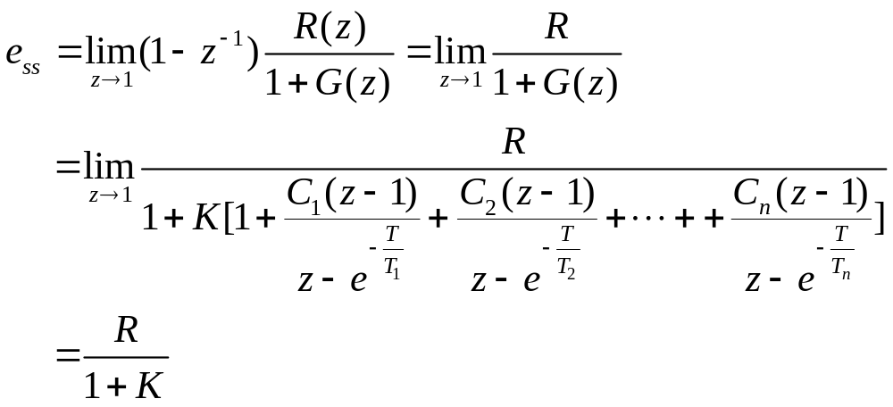
Because
therefore

Slide 23
Transient Response of Discrete Control Systems
The time domain performance specifications such as maximum overshoot, rise
time and settling time used in continuous system can still be applied to discrete
control systems.
The transient performance of a discrete-data control system is characterized by
poles and zeros of the transfer function in the z-plane.
For analysis and design purposes, it is important to study the relation between
the location of the characteristic-equation roots in the z-plane and the time
response of the discrete-date system.
The correlation of a point on the S plane and its mapping on the Z plane?

Slide 24
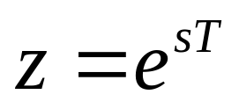

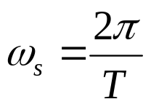



Mapping between s-Plane and z-Plane Trajectories
Where T is the sampling period.
Set
Set

Slide 25
s-Plane
z-Plane
j
ω
Im
z
ω
A
s
2
B
A
B
0
σ
C
0
1
Re
z
C
−
ω
s
2

Slide 26










j
ω
s-Plane
z-Plane
Im
z
ω
A
s
2
B
A
B
0
σ
C
0
1
Re
z
C
−
ω
s
2

Slide 27





Time Response of Discrete Systems
Look at the unit-step response of a general system:
Assume does not have any multiple poles

Slide 28







If is a complex number

Slide 29

z-Plane
y
(
k
)
Im
z
y
(
k
)
0
k
0
k
y
(
k
)
0
k
-1
0
1
Re
z
y
(
k
)
0
k

Slide 30


Transient Responses Corresponding to various pole locations

Slide 31


Transient Responses Corresponding to various pole locations

Slide 32




Controllability and Observability of Systems with Discrete State Equation Models
Controllability condition:
Observability condition:

Slide 33
Design of Discrete-Data Control
Use methods for continuous systems to design an anolog controller first, then
discretize the controller to a digital controller.
To do this, the sampling frequency must be much greater than the gain crossover
frequency of the controller.
There are two commonly used discretization methods, one is the matched
zero-pole method, the other is the bilinear approximation method.

Slide 34











Matched Zero-Pole Method
Determine the gain
Example:
①
②
③

Slide 35





Bilinear Approximation Method
Perform Taylor series expansion and neglect items equal to and higher than the
second order

Slide 36




Physical Significance of Bilinear Transform Method

Slide 37




Physical Significance of Bilinear Transform Method
z transformation

Slide 38
Physical Significance of Bilinear Transform Method
u
(
t
)
y
(
t
)
0
1
2
3
4
5
6
t
Discrete-Data Process
0
1
2
3
4
5
6
t

Slide 39





Example – 7.20
Q: please design a digital controller to make the gain crossover frequency of the
open-loop transfer function and the phase margin
A: find the continuous transfer function of the above system
Transfer function of the ZOH
Transfer function of the ideal sampler

Slide 40



Example – 7.20
When ,
,
which is much greater than
the gain crossover gain .
The discretization condition is satisfied.
Plot the Bode diagram of the given system:
Controlled
Process
R
(
s
)
+
1
T
50
Y
(
s
)
D
(
s
)
T
T
c
s
+
1
s
(
0
.
45
s
+
1
)
-
2
Sampler
Controller
ZOH

Slide 41






L
( )
ω
dB
60
-20
40
34
20
50
200
10
ω
rad/s
0.1
1
2.2
5
100
-20
-40
-40
Corner frequency:
-60
When
Slope:

Slide 42



Design a phase-lead controller:
The compensated system:
dB
60
-20
40
34
20
ω
=
22
Modified Bode Plot
-20
c
50
200
0.1
1
2.
2
5
10
100
ω
rad/s
-20
-40
-40
-60
-60

Slide 43

Matlab simulation of the anolog controller
s=tf('s');
g=50/(s*(0.45*s+1)*(0.005*s+1));
sys=feedback(g,1);
step(sys,’b’);
grid on;
hold on;
c= (0.2*s+1)/(0.02*s+1);
g1=g*c;
sys1=feedback(g1,1);
step(sys1,’r’);

Slide 44







Discretize the analog controller
Use zero-pole matching method
G_{c}(0) = 1
k = 8.02

Slide 45



Use bilinear transform method:
Perform inverse z-transform:

Slide 46


Matlab simulation of the discretization
Zero-Pole Matching
Transfer function:
8.068 z - 7.674
---------------
z - 0.6065
Sampling time: 0.01
s=tf('s');
c=(0.2*s+1)/(0.02*s+1);
c1=c2d(c,0.01,'matched')
Bilinear transform
Transfer function:
8.2 z - 7.8
-----------
z - 0.6
Sampling time: 0.01
s=tf('s');
c=(0.2*s+1)/(0.02*s+1);
c1=c2d(c,0.01,'tustin')

Slide 47
Matlab simulation of the digital controller obtained by zero-pole matching method
Step Response
1.4
g2=c2d(g,0.01,'matched');
c2=c2d(c,0.01,'matched');
g3=c2*g2;
sys2=feedback(g3,1);
step(sys2);
1.2
1
Amplitude
0.8
0.6
0.4
0.2
0
0
0.1
0.2
0.3
0.4
0.5
0.6
0.7
Time (sec)

Slide 48
Matlab simulation of the digital controller obtained by bilinear transform
Step Response
1.4
g2=c2d(g,0.01,'tustin');
c2=c2d(c,0.01,'tustin');
g3=c2*g2;
sys2=feedback(g3,1);
step(sys2)
1.2
1
0.8
Amplitude
0.6
0.4
0.2
0
0
0.1
0.2
0.3
0.4
0.5
0.6
0.7
Time (sec)

Slide 49
Design of Discrete-Data Control
Another way of design a digital controller is to discretize the controlled continuous
system first, then use methods for discrete-data systems to design a digital controller.
Root locus method in z-plane and zero-pole placement in z-plane are two commonly
used methods to design digital controllers. They will be illustrated by the following
examples.

Slide 50






Root Locus Method
Characteristic equation:
Magnitude condition:
Angle condition:

Slide 51
投票
最多可选1项
Are the eight rules for constructing the root loci of
continuous systems still applicable?
A
Yes
B
No
提交

Slide 52




Example – 7.12
Q: please design a discrete-data controller, which makes the modified system satisfy
the following performance specifications: ,
r
(
t
)
+
T
=0.2s
1
y
(
t
)
1
−
e
−
Ts
s
s
(
s
+
2
.
5
)
-
Discrete-data
Controller
ZOH
Controlled
Process
A: find the z-transfer function of the original system:

Slide 53

Substitute T=0.2s into the above function:
Root loci of the original system:
Im(z)
Unit circle
-
2.49
-
1
-
0.8474
1
Re(z)

Slide 54






The poles’ locations of the desired system:
The damped oscillatory frequency:
The sampling frequency:
The coordinates of the desired
dominant poles on the s-plane:

Slide 55





The coordinates of the desired
dominant poles on the z-plane:

Slide 56



To satisfy the angle condition, the angle needs to be compensated is:

Slide 57




Design a phase-lead controller with a z-transfer function of:
Use zero-pole cancellation method to determine the value of a, then use angle
condition to determine b.
θ₁−ϕ₁−ϕ₂=17.43⁰−138.52⁰−58.91⁰=−180⁰

Slide 58
The root loci of the compensated system:
Im(z)
Desired Poles
P
Unit Circle
-
2.28
-
1
-
0.8474
0.2575
1
Re(z)

Slide 59




Use magnitude condition to determine the open-loop gain:
Apply the inverse z-transform:

Slide 60
Matlab Simulation
z=tf('z',0.2);
g=0.01704*(z+0.8474)/((z-1)*(z-0.6065));
sys=feedback(g,1);
step(sys,’b’);
hold on; grid on;
c=13.27*(z-0.6065)/(z-0.2575);
g1=c*g;
sys1=feedback(g1,1);
step(sys1,’r’);
Step Response
1.4
1.2
After
1
0.8
Before
Amplitude
0.6
0.4
0.2
0
0
2
4
6
8
10
12
Time (sec)

Slide 61






Pole Placement through State Feedback
Discrete-date state equation
State feedback
Characteristic equation
after state feedback
Example:
please place the poles at for the following system.

Slide 62




A: check the controllability of the system:
system is
controllable
Characteristic equation of the desired system:
Characteristic equation of the system after introducing state feedback:
k₁ =0.34，k₂ = -2

Slide 63
Wrap-Up
Stability assessment of discrete-data systems
Steady-state error of discrete-data systems
Transient response of a discrete-data system
Mapping between s-plane and z-plane trajectory
Design a discrete-data controller through discretizing a continuous-data controller
Design a discrete-data controller in the z-plane

Slide 64

Assignment
Page 179—180
6
7
10， (1)
11 ，(2)

